Slide 1
IST 645 Final Presentation: Implementation of Neurala AI Visual Inspection at Floyd Furniture Group 2: Michael D'Amore, Smita Deulkar, Seayon Dsilva, Dhananjay Pawar, Dhrumil Shah, Tejas Vanavale

Slide 2


Project Overview
Floyd Furniture is integrating Neurala’s AI-powered visual inspection system across two key product lines: Round Table and Shelving Units.
This strategic initiative aims to address product inconsistencies and reduce manual inspection dependency.
The project will deploy VIA for surface defect detection and part kitting validation, tailored to Floyd’s dynamic product variants.
Objectives: Boost inspection accuracy, optimize operational efficiency, reduce waste, and meet investor expectations.

Slide 3

Vision of the Future
Shift from sample-based to 100% in-line automated inspection.
All components and product surfaces will be validated in real time with multi-ROI AI models.
Human error in part selection and visual QA is eliminated.
Neurala + Salesforce integration ensures seamless data flow, issue logging, and inspection traceability.

Slide 4

Strategic Benefits
Quality: Early defect detection, better rework control.
Speed: Real-time feedback minimizes delays.
Scalability: Easy model retraining for new product lines.
Cost Saving: Reduction in labor costs and defective output.
Compliance: Improved audit trails through integrated reporting.

Slide 5
Scheduling Assumptions & Constraints
Start Date: September 10, 2024
Sponsor Approval: November 6, 2024 post-deck presentation
Sprints: All configuration and testing occur in 2-week Agile sprints
Constraints:
Shipment lead time for inspection hardware
Contract start of Salesforce advisor (Aurelia Johnson)
AI training contingent on live production image data

Slide 6

Project Stages
1. Planning & Approvals (Predictive)
2. Procurement & Initial Installation (3 Sprints)
3. Software Configuration + AI Model Training (4 Sprints)
4. Manufacturing Testing (2 Sprints)
5. Final QA with Manual Review (300 units)
6. Team Training Workshops (180 hrs)
7. Closure & Reporting

Slide 7

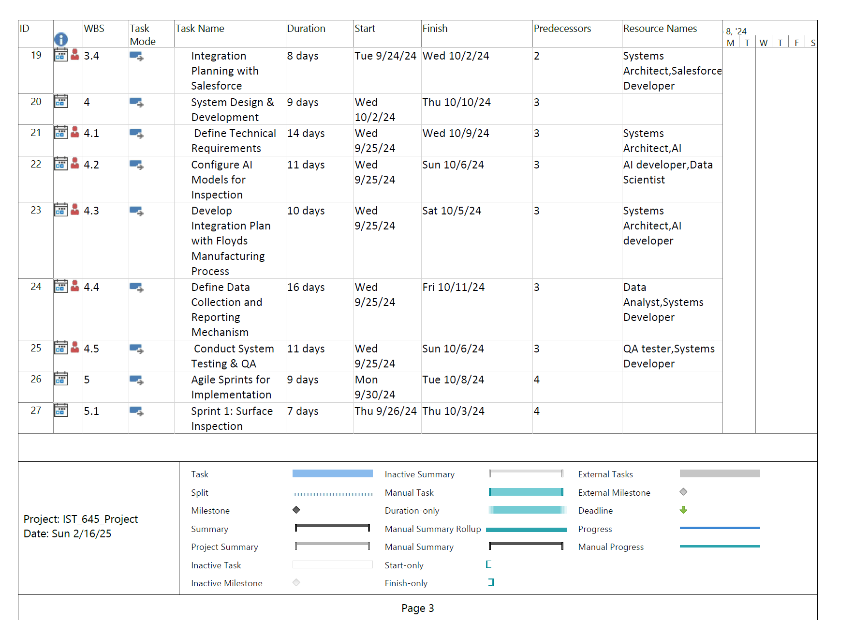


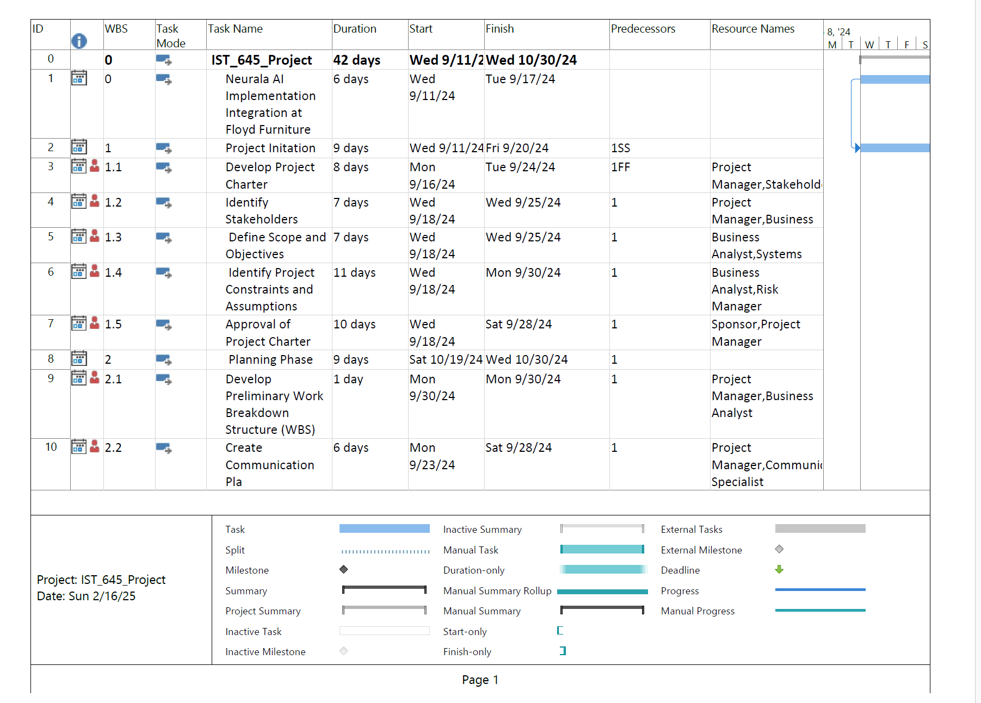
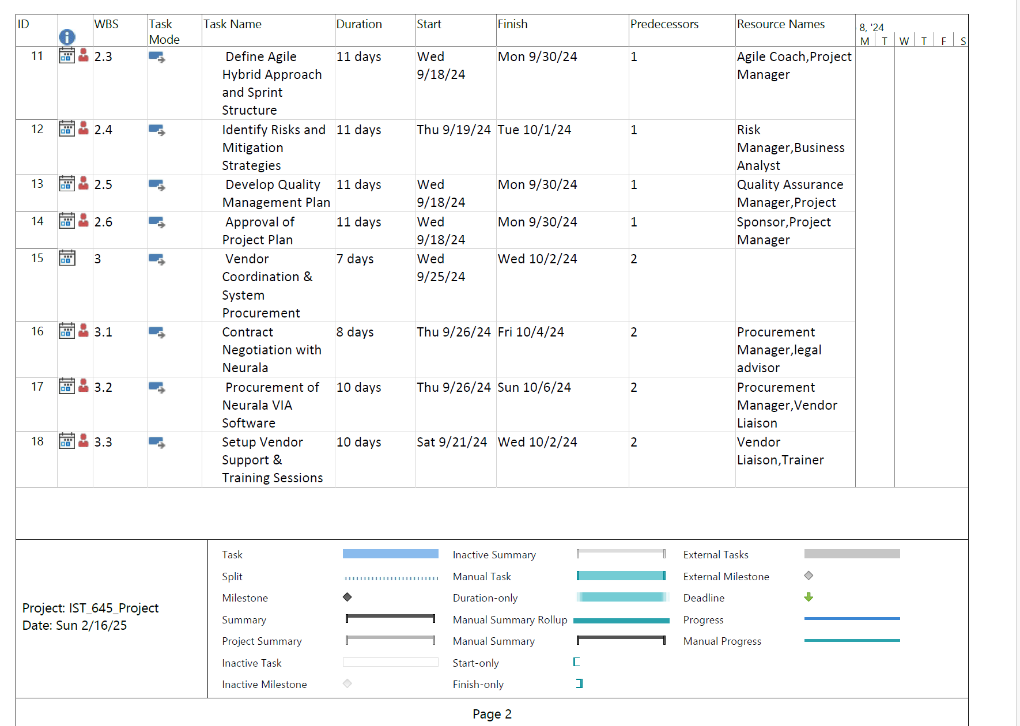

Preliminary Work Breakdown Structure for 1B
Key Highlights: (Early Project Stages: Laying the Foundation)
1) Project Goal: Neurala AI Implementation Integration at Floyd Furniture.
2) Overall Duration: 42 days (starting Wednesday, September 11, 2024, and finishing Wednesday, October 30, 2024).
3) Duration of Initial Tasks: Approximately 9 weeks (Sep 11 - Oct 30, 2024)
4) Key Focus: Project Definition and Planning
5) Next Steps: Transition to subsequent project phases (as detailed in the full plan)
Key Highlights: (Procurement and Initial Vendor Engagement)
Project Goal: Neurala AI Implementation Integration at Floyd Furniture.
Overall Duration (as depicted in this segment): Approximately 6 weeks (starting Wednesday, September 25, 2024, and finishing Wednesday, November 6, 2024, considering the latest finish date shown).
Duration of Focused Tasks: This segment covers tasks ranging from 7 to 10 days each.
Key Focus: Vendor coordination, system procurement, contract negotiation, and initial setup/training for the Neurala VIA software.
Next Steps: Progression into the actual implementation and integration phases of the Neurala AI solution (as detailed in the full plan beyond this excerpt).

Slide 8
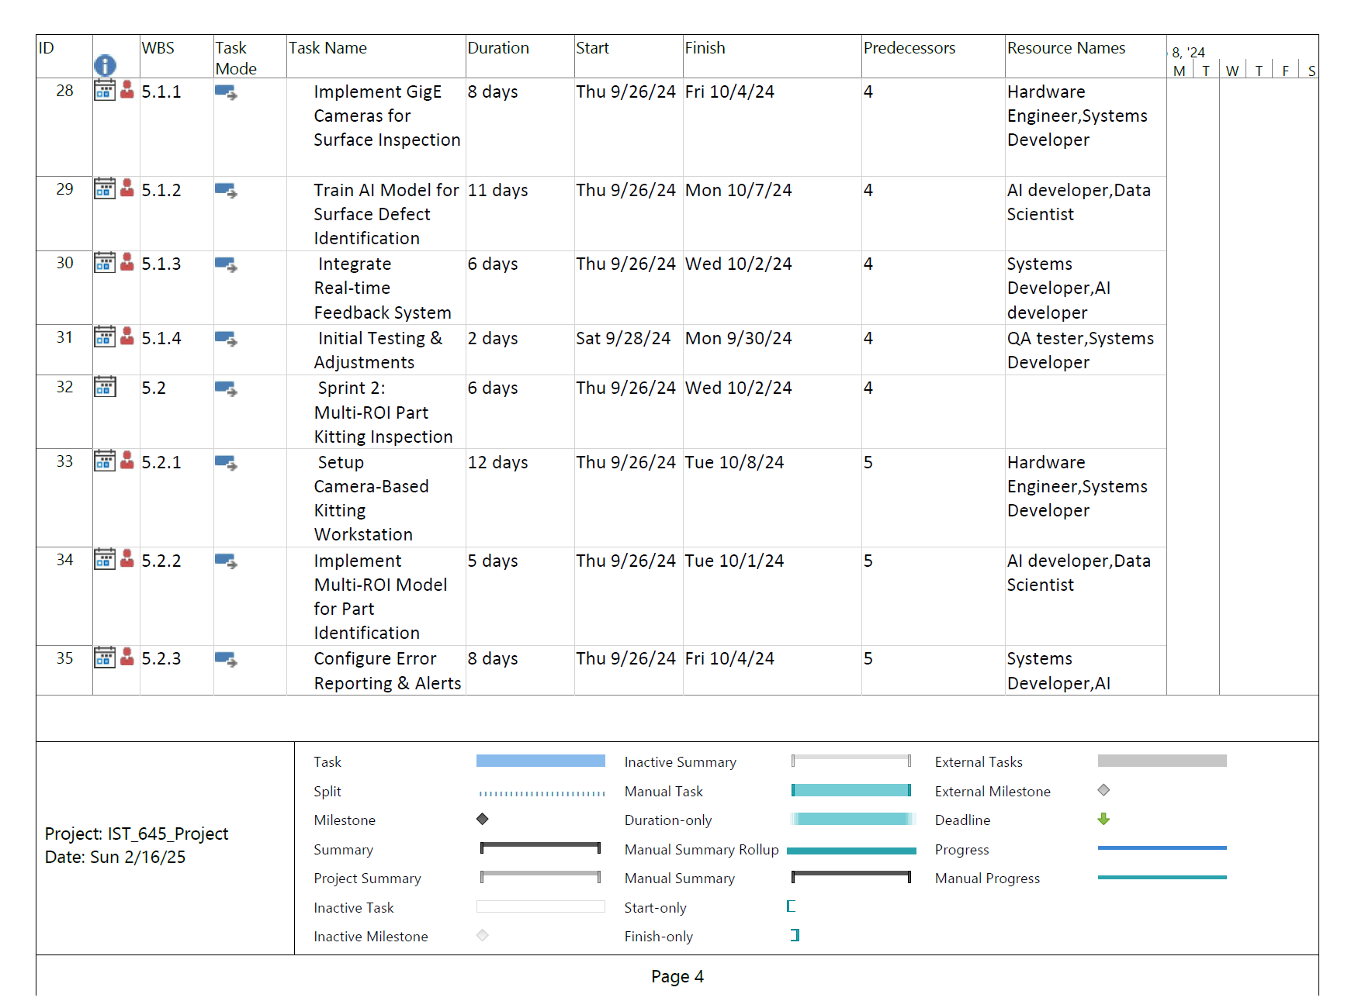
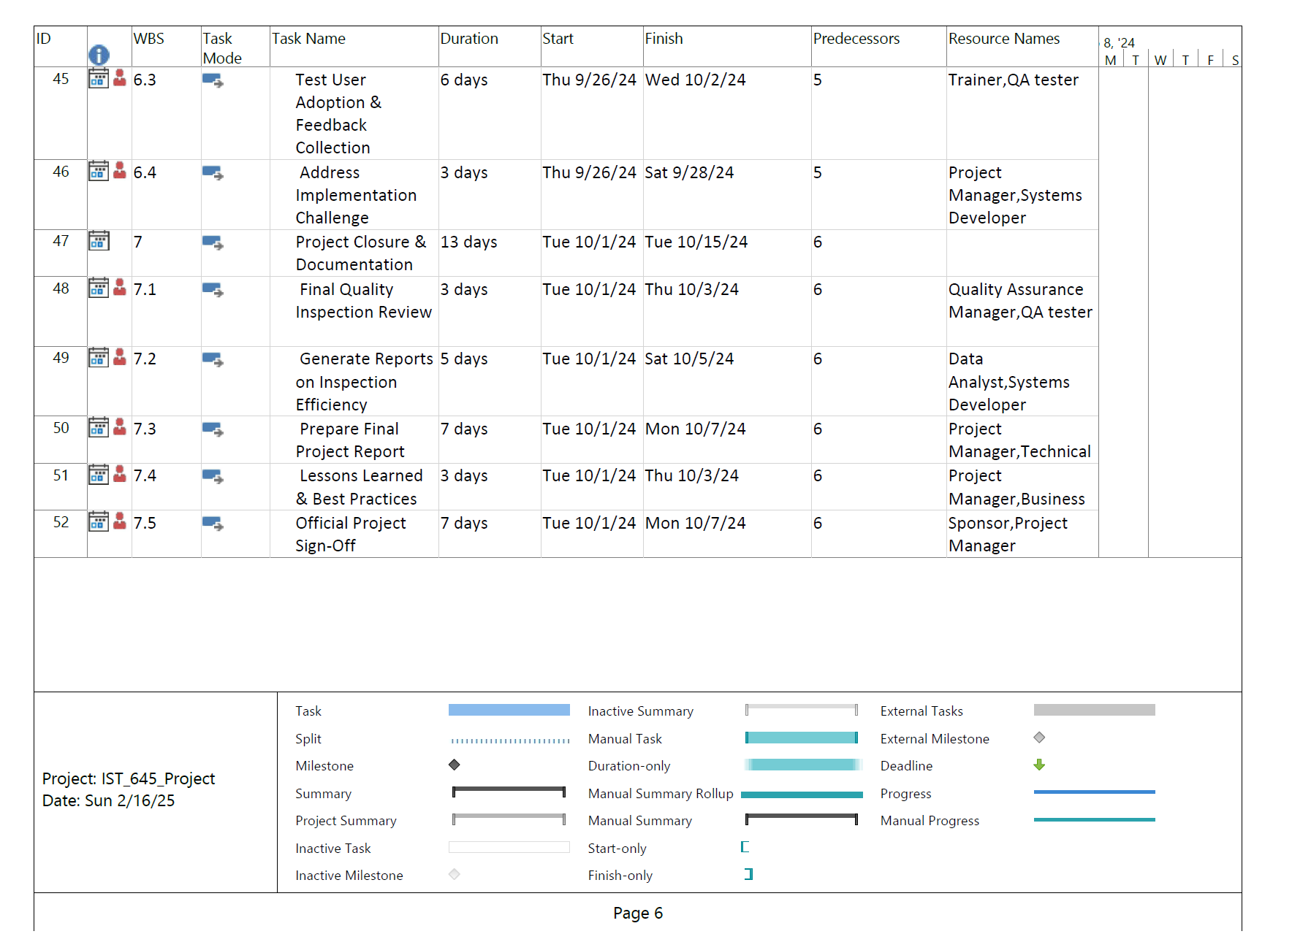
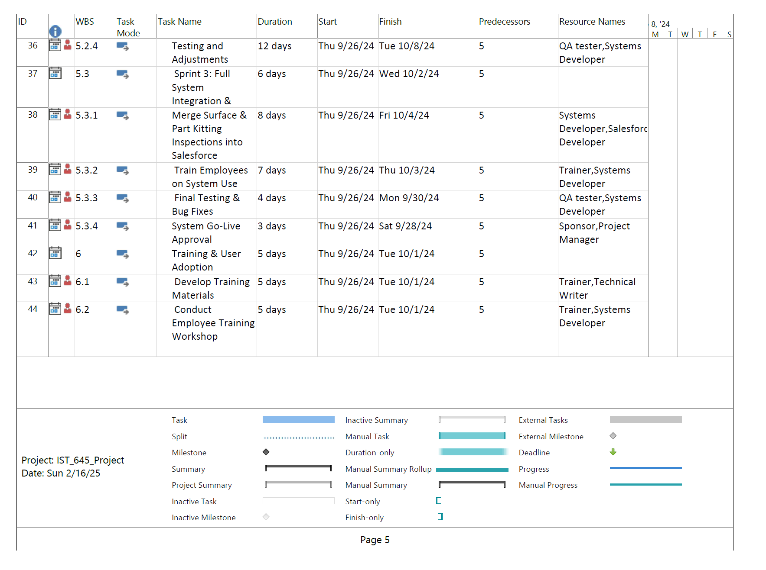
Brief Explanation for the Preliminary Work Breakdown Structure for 1B
Key Highlights: (System Design, Development, and Initial Integration)
1. Project Goal: Neurala AI Implementation Integration at Floyd Furniture.
2. Overall Duration (as depicted in this segment): Approximately 7 weeks (starting Tuesday, September 24, 2024, and finishing Thursday, November 14, 2024, considering the latest finish date shown).
3. Duration of Focused Tasks: This segment includes tasks with durations ranging from 7 to 16 days.
4. Key Focus: Integrating with existing Salesforce, defining technical requirements, configuring AI models, developing the integration plan for Floyd's manufacturing process, defining data collection and reporting, and conducting initial system testing and QA.
5. Next Steps: Moving into iterative development cycles (Agile Sprints) for implementation, starting with a surface inspection sprint, and likely continuing with further sprints and refinement based on testing and feedback (as detailed in the full plan).
Key Highlights: (User Adoption, Project Closure, and Finalization)
Project Goal: Neurala AI Implementation Integration at Floyd Furniture.
Overall Duration (as depicted in this segment): Approximately 3 weeks (starting Thursday, September 26, 2024, and finishing Monday, October 7, 2024, based on the latest finish date).
Duration of Focused Tasks: The tasks in this section range from 3 to 13 days in duration.
Key Focus: Gathering user feedback and addressing implementation challenges, formally closing the project and documenting its outcomes, conducting a final quality inspection review, generating reports on inspection efficiency, preparing the final project report with best practices and lessons learned, and obtaining official project sign-off.
Next Steps: Formal project closure, dissemination of findings and best practices, and potentially moving into a support and maintenance phase (though not explicitly detailed in this excerpt).

Slide 9
Quality Planning, Assurance & Control
Approach:
Agile implementation via test-focused sprints
Predictive closure and reporting
Tools:
Neurala’s Explainability for transparent model output
Manual QA comparison for defect rate benchmarks
Monitoring:
Surface Inspection via Anomaly Recognition
Part Kitting via ROI-based Scene Recognition

Slide 10
Risk Management
Top Risks:
Delayed hardware delivery
Poor-quality image data
Lack of stakeholder adoption
Mitigation:
Staggered procurement
Pre-training image capture with placeholder models
Clear training curriculum + staff Q&A

Slide 11
Communication & Stakeholder Support
Weekly syncs with Sponsor (Josh Oswald)
Sprint reviews include Neurala (Jeffrey, Ben) and Aurelia (Salesforce)
Staff feedback loop via CX Lead (Sarah Broadwater)
Stakeholder matrix and communication chart in project repository

Slide 12
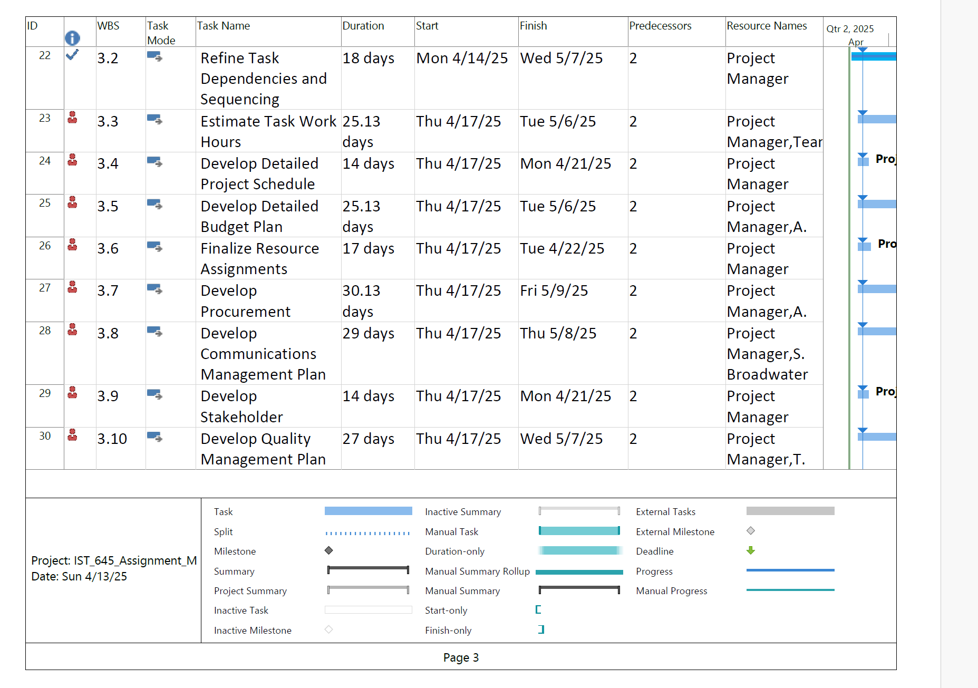
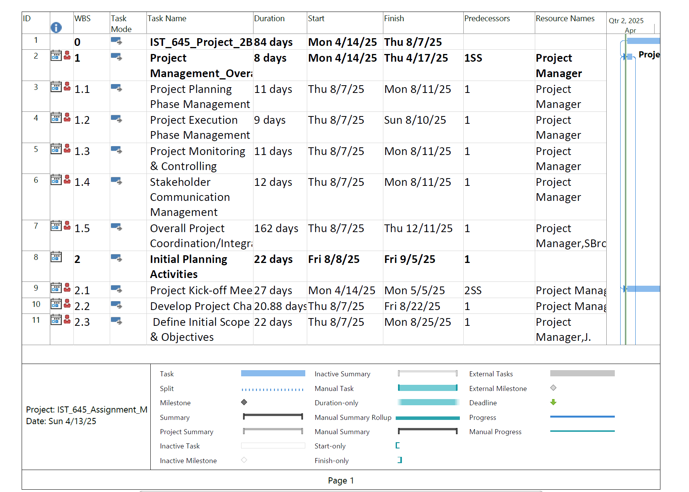
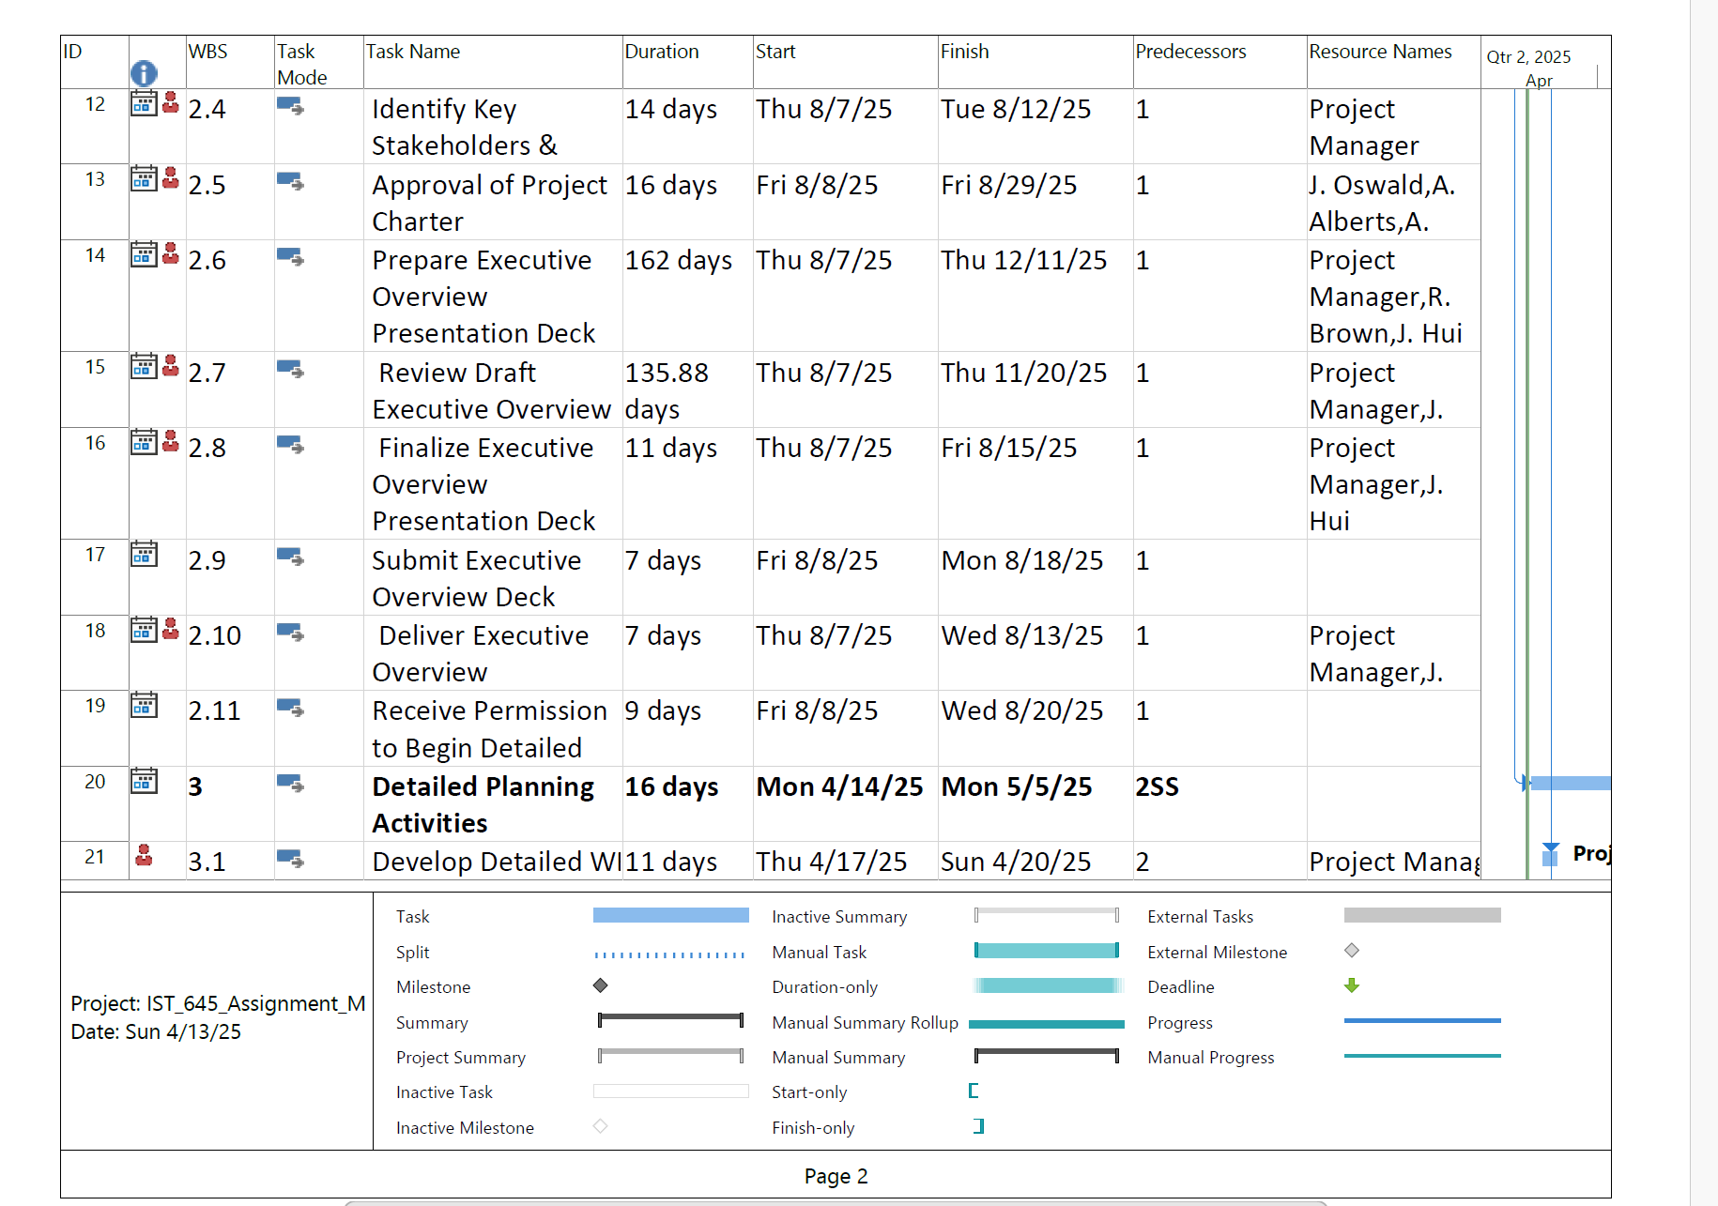
Final Project Schedule and Budget
Key Highlights: (Initial Project Setup and Scope Definition)
Project Goal: IST_645_Project.
Overall Duration (initial phase): 8 days (Mon 4/14/25 - Thu 4/17/25) for the top-level summary. The "Overall Project Coordination/Integration" lasts 162 days (Thu 8/7/25 - Thu 12/11/25).
Duration of Initial Tasks: Project planning tasks are around 9-12 days. "Initial Planning Activities" take 22 days (Fri 8/8/25 - Fri 9/5/25).
Key Focus: Setting up project management framework. This includes defining phases and communication. Initial planning starts with a kick-off. Defining scope and objectives follows.
Next Steps: Conduct the project kick-off meeting. Develop the project charter. Further define initial scope and objectives. More detailed planning will likely follow.
Key Highlights: (Stakeholder Identification and Executive Approval)
Project Goal: IST_645_Project.
Overall Duration (this segment): Approximately 16 weeks (Thu 8/7/25 - Mon 11/24/25, considering the latest finish). "Detailed Planning Activities" span 16 days (Mon 4/14/25 - Mon 5/5/25).
Duration of Initial Tasks: Tasks range from 7 to 162 days. Identifying stakeholders takes 14 days. Project charter approval takes 16 days. Preparing the executive overview is a long task (162 days).
Key Focus: Identifying key stakeholders. Gaining approval for the project charter. Creating and finalizing an executive overview presentation. Obtaining permission to begin detailed planning.
Next Steps: Develop detailed work breakdown structure. This will likely involve more specific task definitions. Resource allocation will follow.

Slide 13
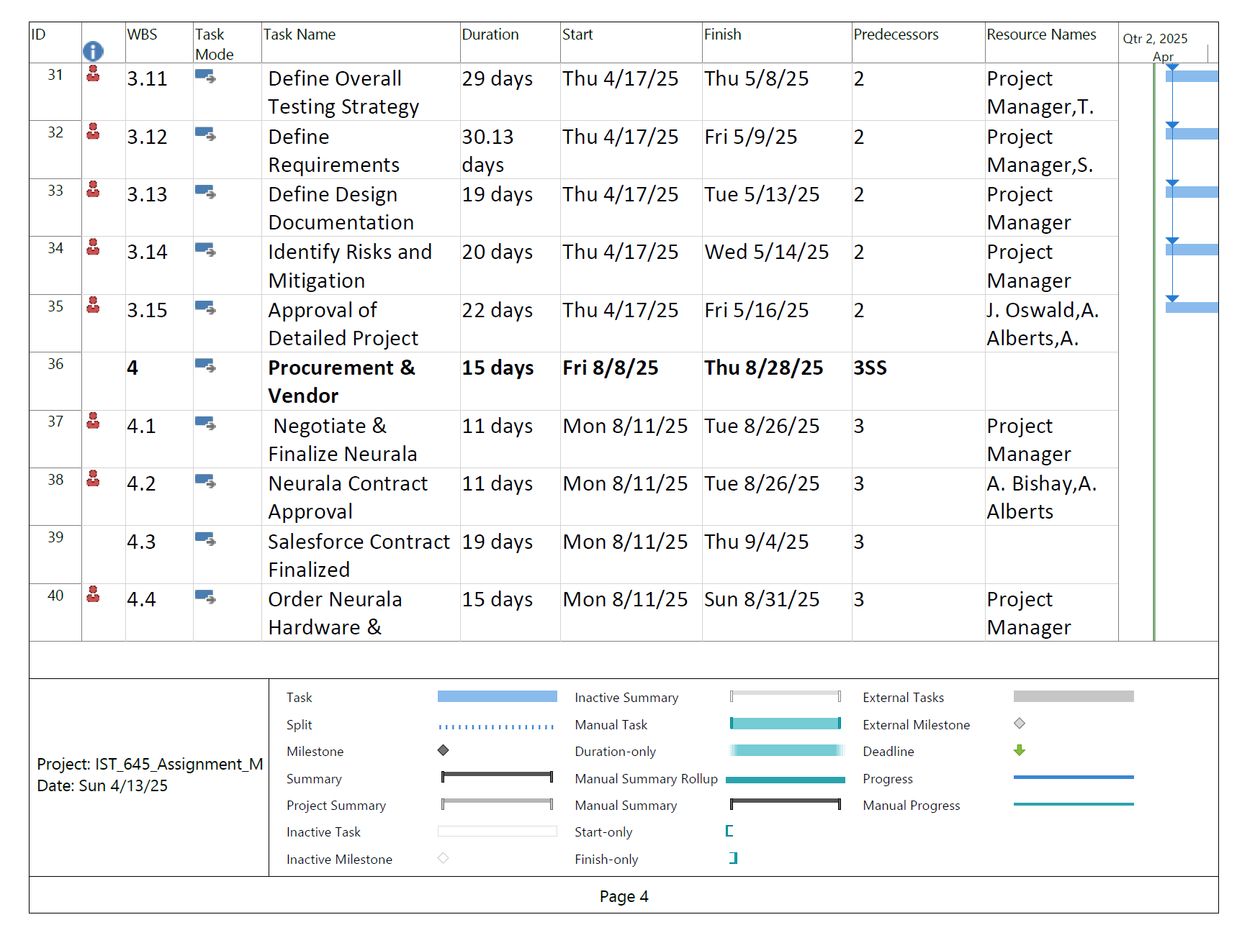
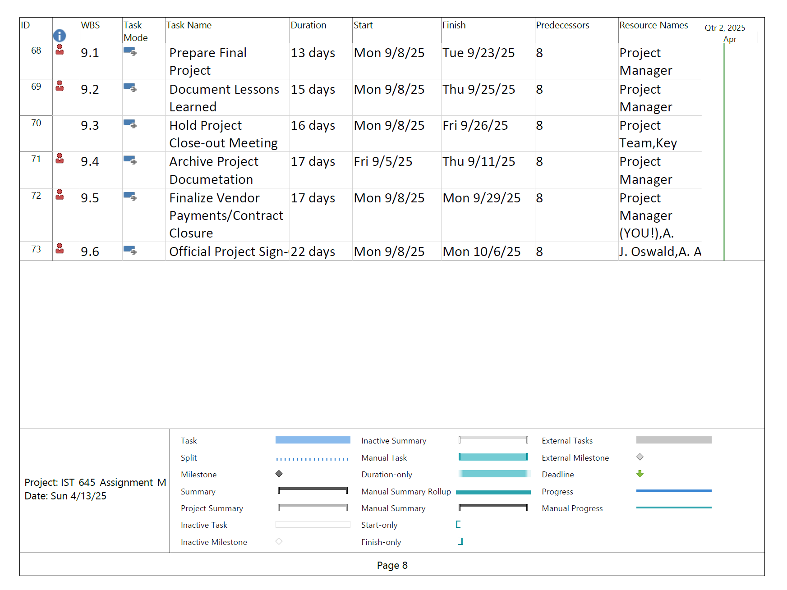
Brief Explanation for the Final Project Schedule and Budget
Key Highlights: (Detailed Planning and Initial Procurement)
Project Goal: IST_645_Project.
Overall Duration (this segment): Approximately 4 months (Thu 4/17/25 - Sun 8/31/25, considering the latest finish). The "Procurement & Vendor" phase is 15 days (Fri 8/8/25 - Thu 8/28/25).
Duration of Initial Tasks: Detailed planning tasks range from 19 to 30.13 days. Approval of the detailed project plan takes 22 days. Procurement activities are around 11-19 days. Ordering Neurala hardware takes 15 days.
Key Focus: Defining the overall testing strategy. Defining detailed requirements and design. Identifying risks and mitigation. Gaining approval for the detailed project plan. Starting the procurement process. This includes negotiating contracts.
Next Steps: Move into the execution phase after planning. Begin vendor and hardware procurement. This involves finalizing contracts. Ordering necessary equipment follows.
Project Goal: IST_645_Project.
Overall Duration (this segment): Approximately 6 weeks (Mon 9/8/25 - Mon 10/6/25).
Duration of Initial Tasks: Tasks range from 13 to 22 days. Preparing the final project report takes 13 days. Documenting lessons learned takes 15 days. Holding a project close-out meeting takes 16 days. Archiving project documentation takes 17 days. Finalizing vendor payments takes 17 days. Obtaining official project sign-off takes 22 days.
Key Focus: Formal project closure. This includes finalizing documentation and finances. It also involves gathering lessons learned. A final meeting will occur. Official sign-off concludes the project.
Next Steps: Project is considered complete after official sign-off. Resources will likely be reallocated. Final project deliverables are considered complete.

Slide 14
Comparison between 1B and 2B Microsoft Project
Feature | Neurala AI Implementation | IST_645 Project
Project Goal/Focus | Implementing Neurala AI at Floyd Furniture, specifically for inspection efficiency. | A more general "IST_645_Project" focused on project management processes. The specific deliverable isn't as tightly defined in the initial stages.
Timeframe | Shorter, more concentrated timeframe. The main implementation push appears to be within a few months. | Longer overall duration. The project spans multiple phases over a more extended period (many months).
Level of Detail (Initial vs. Later) | Starts with a high-level summary but quickly gets into specific implementation tasks (e.g., vendor coordination, hardware procurement, software configuration). | Begins with a strong emphasis on project management processes (phases, communication, etc.) and then dives into detailed planning activities. The initial focus is less on the "what" and more on the "how" of managing the project.
Task Dependency Complexity | Has a moderate level of task dependencies, reflecting the sequential nature of implementation (e.g., procurement before setup). | Also has dependencies, but there's a greater emphasis on parallel planning activities and management oversight throughout the project lifecycle.
Resource Allocation Detail | Clearly assigns specific roles (e.g., Project Manager, Trainer, QA Tester) to tasks, indicating a focus on resource utilization within the implementation. | Focuses on project management roles initially (Project Manager) and then expands to development and implementation teams later.
Closure Emphasis | Highlights user feedback and efficiency reporting as key closure activities. This is tied to the specific AI implementation goal. | Emphasizes general project closure procedures (documentation, lessons learned, sign-off) applicable to any project.

Slide 15
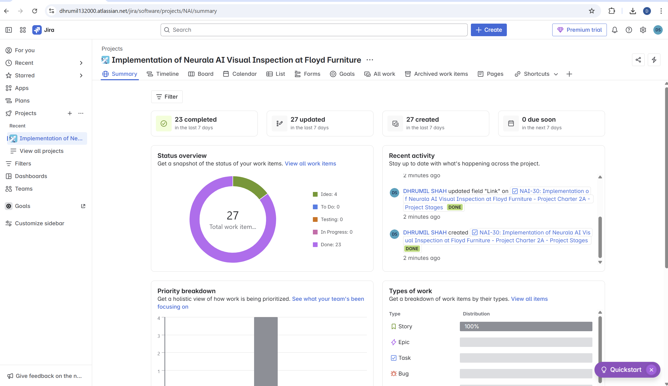
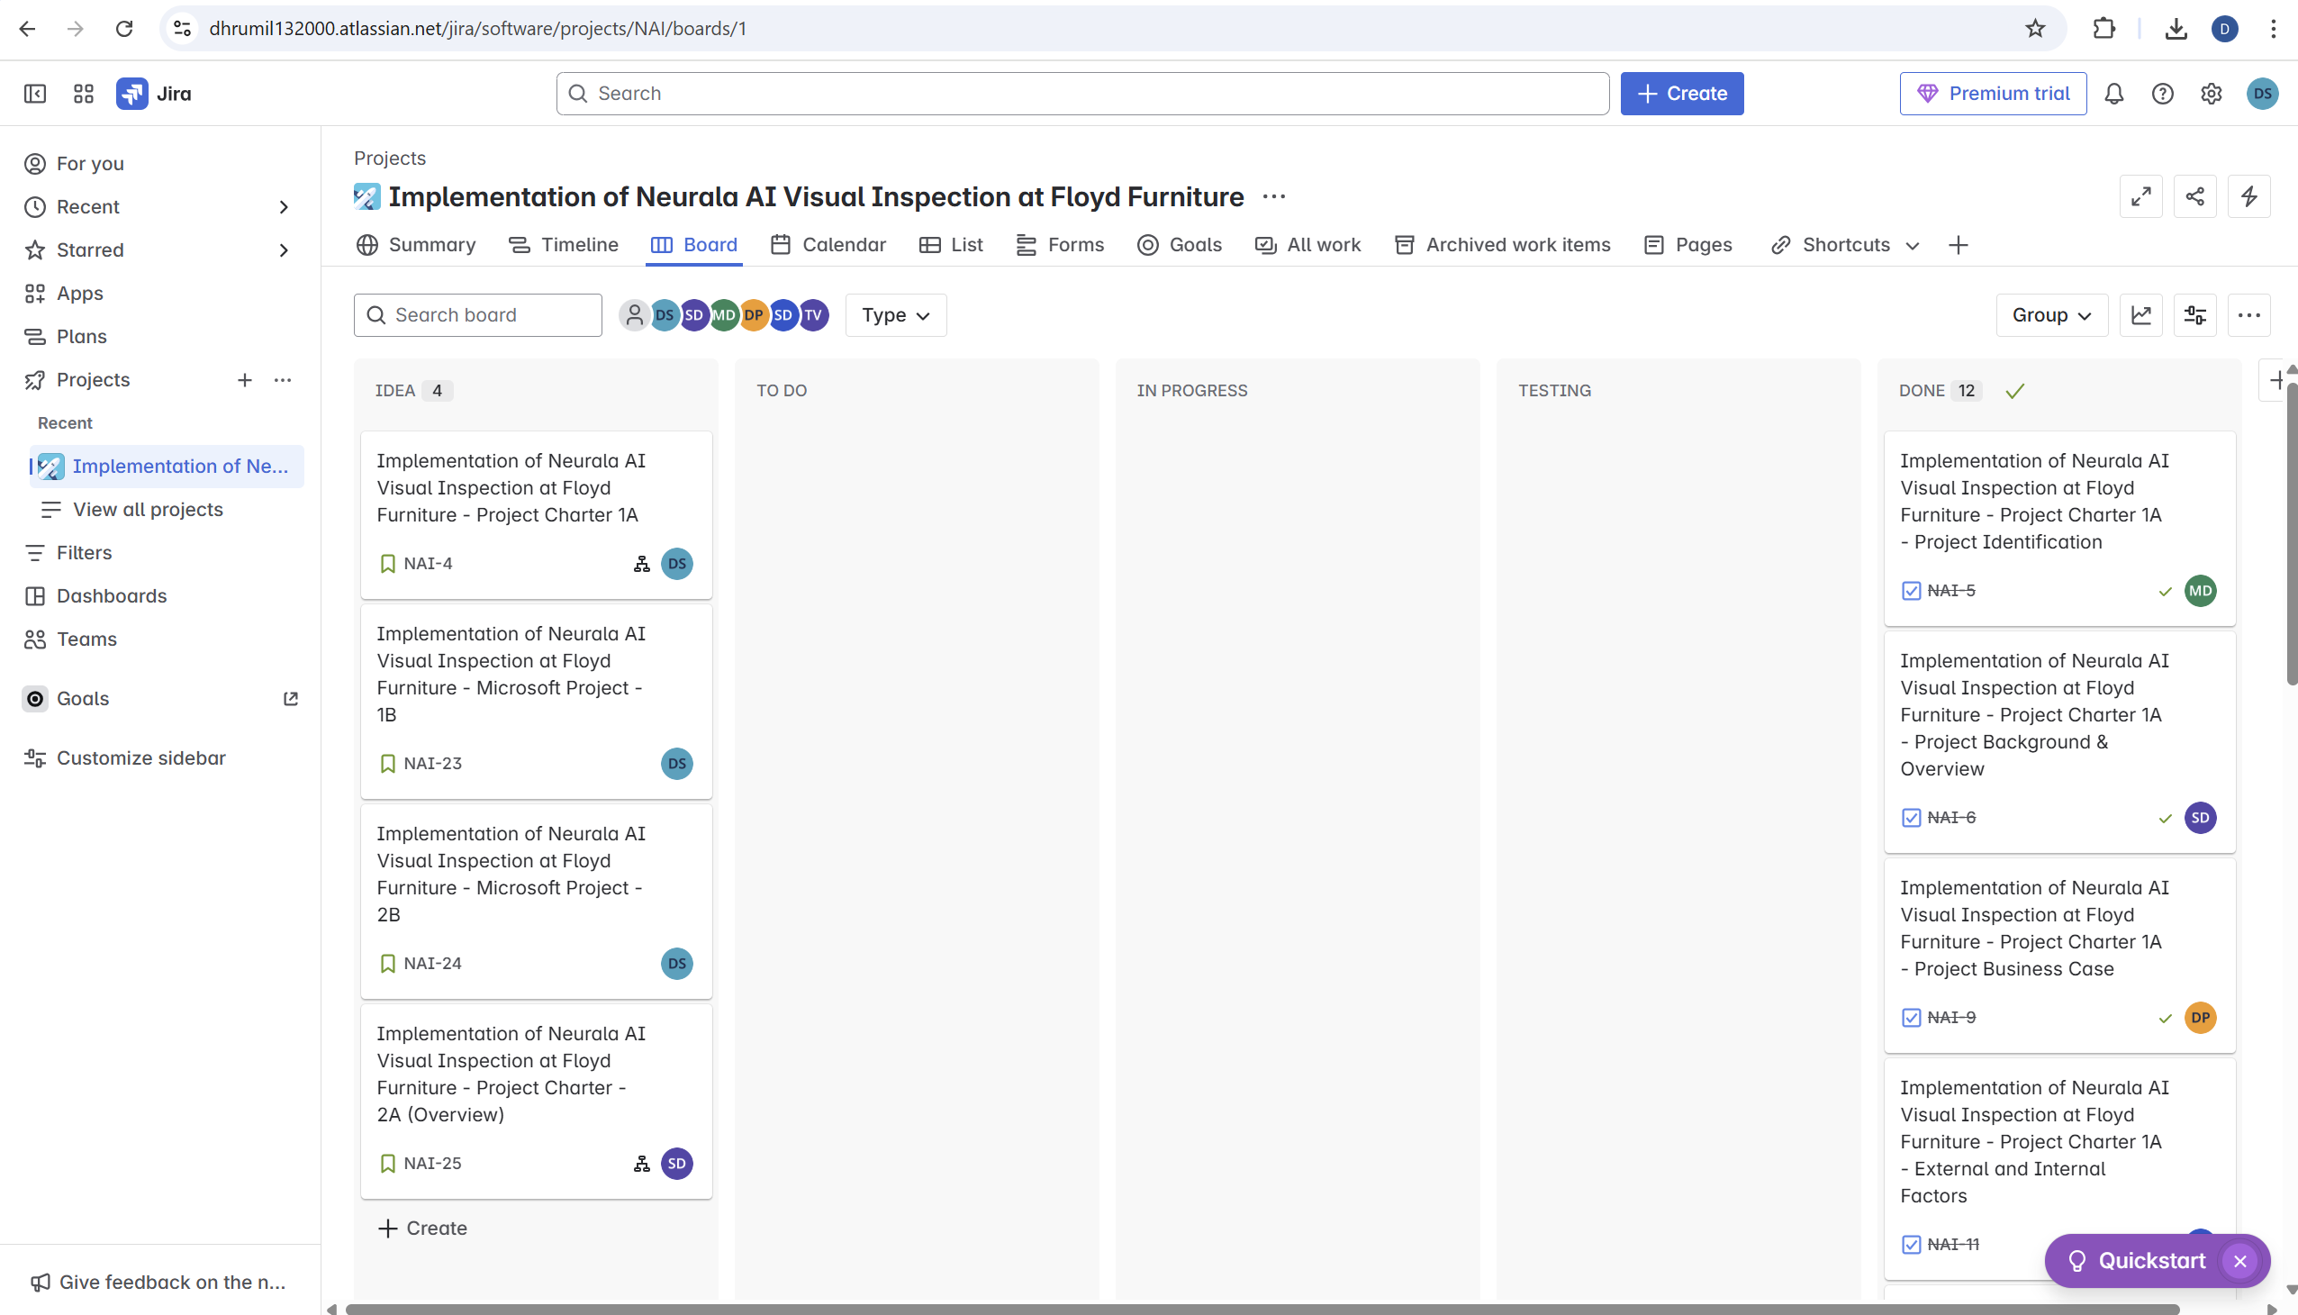
Jira – Implementation of Neurala AI Visual Inspection at Floyd Furniture
Jira Project board - https://dhrumil132000.atlassian.net/jira/software/projects/NAI/boards/1
Jira Project Name and Project key – (Implementation of Neurala AI Visual Inspection at Floyd Furniture – NAI)
All Jira Story boards ( 4 – Story & 23 –Tasks with subtasks attached to each story)
https://dhrumil132000.atlassian.net/browse/NAI-4 (Implementation of Neurala AI Visual Inspection at Floyd Furniture - Project Charter 1A)
https://dhrumil132000.atlassian.net/browse/NAI-23 (Implementation of Neurala AI Visual Inspection at Floyd Furniture - Microsoft Project - 1B)
https://dhrumil132000.atlassian.net/browse/NAI-25 (Implementation of Neurala AI Visual Inspection at Floyd Furniture - Project Charter - 2A (Overview))
https://dhrumil132000.atlassian.net/browse/NAI-24 (Implementation of Neurala AI Visual Inspection at Floyd Furniture - Microsoft Project - 2B)

Slide 16
Use Case Applications
Surface Inspection:
Detects scratches, discoloration, or incorrect finishes
Live validation without stopping production
Part Kitting:
Validates part presence, placement, and fit
Barcode-driven ROI inspection per part zone
Reduces assembly line delays from part mismatches

Slide 17
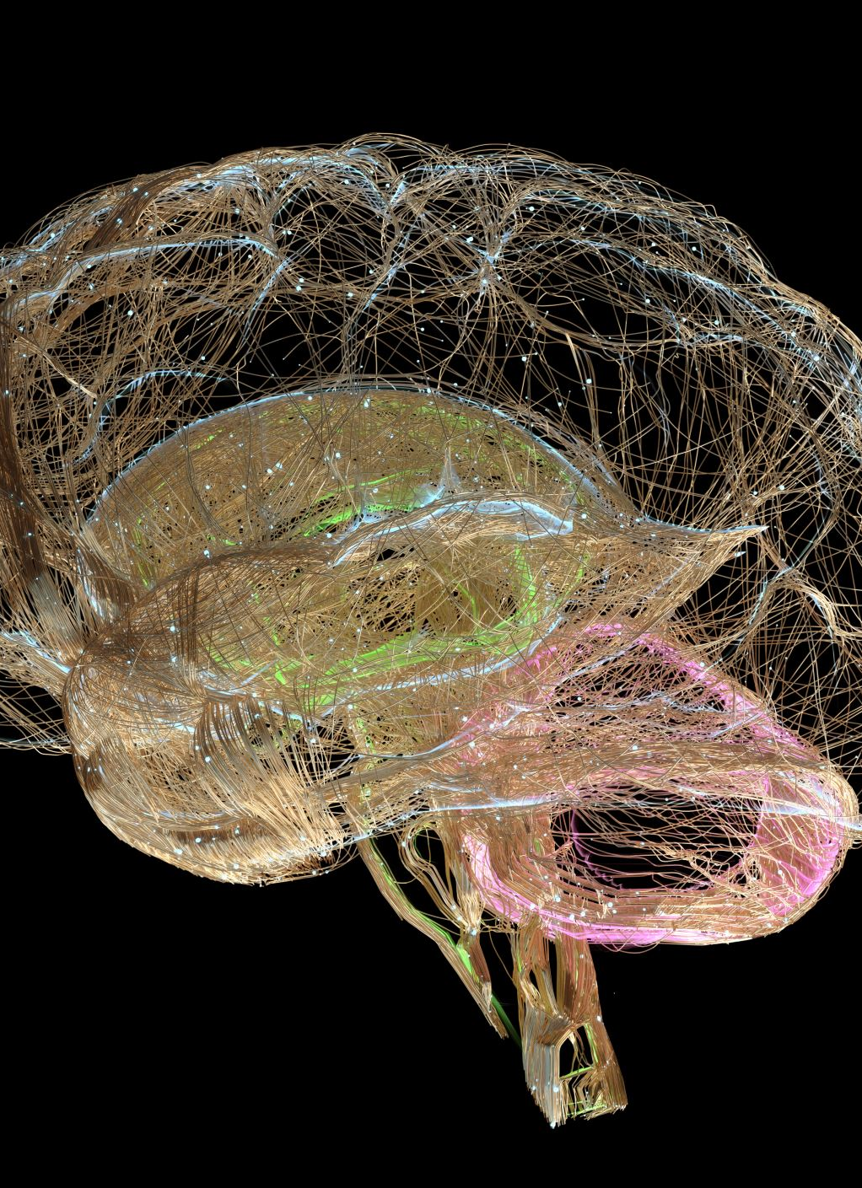
Brain Builder Platform Integration
Built-in tagging, training, and deployment in a unified SaaS environment
Operates with few training images (50–100 per class)
Edge-ready: deploys on-site without cloud dependency
Provides analytics, explainability, and model governance

Slide 18
Lessons Learned
Early Planning Is Critical: Getting executive alignment and a detailed scope early avoided mid-project confusion.
Agile + Predictive Hybrid Worked Well: Agile sprints enabled iterative improvements, while predictive elements ensured deadlines were met.
Training Is a Key Success Factor: Staff adoption increased significantly when training was broken into smaller workshops with feedback loops.
Data Quality Determines AI Success: The success of VIA models was directly tied to the quality and representativeness of training images.
Collaboration Accelerated Progress: Regular syncs with Neurala and Salesforce teams ensured smooth integration and minimized bottlenecks.
Clear Communication Channels Prevented Delays: Defined stakeholder roles and communication plans helped resolve issues quickly.

Slide 19

Future Scope
Expansion to Additional Product Lines: Extend VIA-based inspection to chairs, desks, and storage modules.
Predictive Maintenance Integration: Utilize AI to monitor machine health and flag maintenance needs in real time.
Enhanced Analytics Dashboard: Incorporate real-time dashboards powered by integrated Salesforce + VIA data.
Cloud-Based Model Training: Leverage cloud infrastructure for centralized training, collaboration, and scalability.
Continuous Learning Models: Enable models to learn from ongoing production data, improving over time.
Customer-Facing Quality Insights: Offer end-customers traceable quality reports tied to their purchased items.

Slide 20
Thank You

